Slide 1
Type Your Name Here
Student Name
Instructions
This Digital Interactive Notebook is designed to help you better understand the period of Manifest Destiny and expansion in America. It includes pages on vocabulary terms, people, and key events of this period.
On each page you will see blue text boxes where you can type responses. Simply click in the box and begin typing to provide your response. You can also add your own text boxes by clicking on the text box icon ( ). You also will need to add images to various pages. You can do this by clicking on the “Image” icon ( ) or by going to “Insert > Image” in the menu.
Each text box can also be resized using the borders so that each fits on your pages.

Slide 2
Manifest Destiny Illustrated Vocabulary
Directions: Research each vocabulary term below and type your own definition in the 2nd column. Then look for an image that best symbolizes it and insert it in the 3rd column.
Vocabulary | Definition | Image
Manifest Destiny
The Alamo
Sectionalism
Exodusters
Gold Rush
49ers
Homestead Act

Slide 3
The Battle of the Alamo
Directions: The Battle of the Alamo in 1836 was a pivotal event in the Texas Revolution and American History. First find a picture of the Alamo and paste it below. Then complete the boxes by researching who the Alamo’s defenders were and why they were inside the fort, who the attackers were and why they were attacking the Alamo, and what happened and its impact.
The Alamo’s Attackers
Type your response here.
The Alamo’s Defenders
Type your response here.
Results of the Battle
Type your response here.

Slide 4
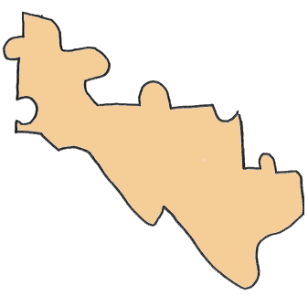
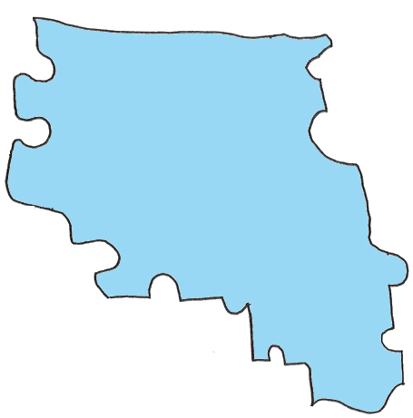
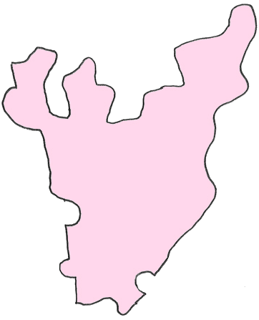
Piecing Together America
Directions:The continental United States came together in chunks throughout the 1800’s. Form a map of the complete continental United States by spinning, dragging, and dropping each region. Then in add a textbox next to each one, label 1) what this region is; 2) when it became part of the United States; and 3) how it became part of the United States

Slide 5
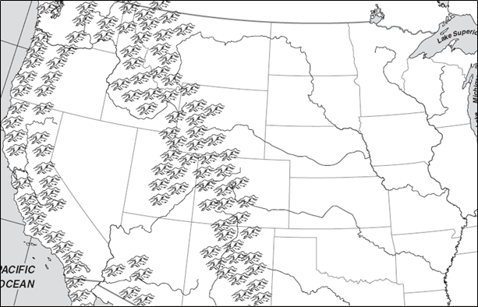
The Oregon Trail
Directions: One of the most popular routes to the west in the mid-1800’s was the 2,000 mile Oregon Trail. Research about the trail then use the “Scribble” tool to draw in the route of the Oregon Trail. Finally, complete the boxes below with what you learned about the trail’s history.
Who?
What?
When?
Where?
Why?
How?

Slide 6
Indian Wars Timeline
Directions: As American settlers moved West, they frequently came into conflict with American Indians. Research about battles, events, and treaties of the American Indian Wars. Drag and drop the events into the correct places on the timeline, then insert “Callout” boxes pointing to each and briefly explain the significance in each one.
1830
1840
1850
1860
1870
1880
1890
Drag & Drop
Battle of Little Bighorn
Sand Creek Massacre
Sioux Wars
Indian Removal Act
Wounded Knee Massacre
Dawes Act (Allotment Act)
Treaty of Fort Laramie

Slide 7
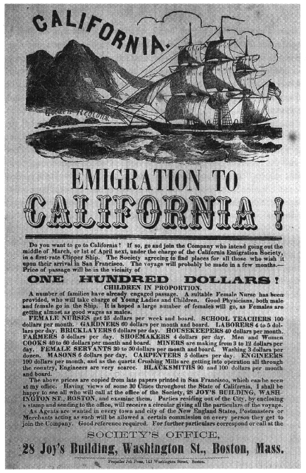
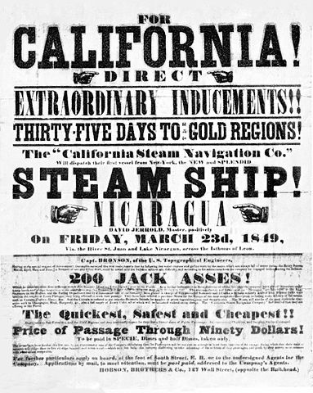
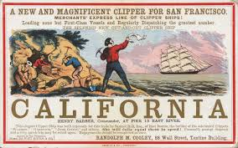
The California Gold Rush
Directions: The discovery of gold in Northern California in 1848 radically changed America as the subsequent Gold Rush brought thousands to the West Coast. Create an advertisement to bring people to California on the template below. Be sure to include graphics/images and describe the the journey to California, the cost of the trip, tools needed, and how they will get there.

Slide 8
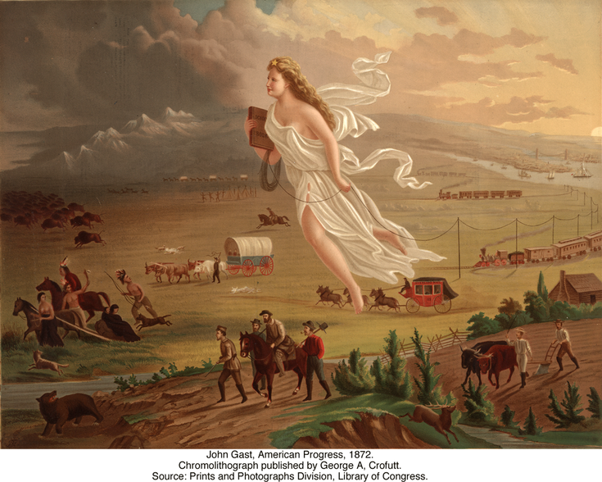
Manifest Destiny
Directions: Artist John Gast’s 1872 painting “American Progress” has come to symbolize Manifest Destiny and the groups affected most by it. Research more about the painting, then complete the graphic organizers by explaining more about the American Frontier, who is pictured and how Manifest Destiny impacted them.
Cowboys
Type your response here.
Railroads
Type your response here.
American Indians
Type your response here.
49ers
Type your response here.
Farmers
Type your response here.

Slide 9
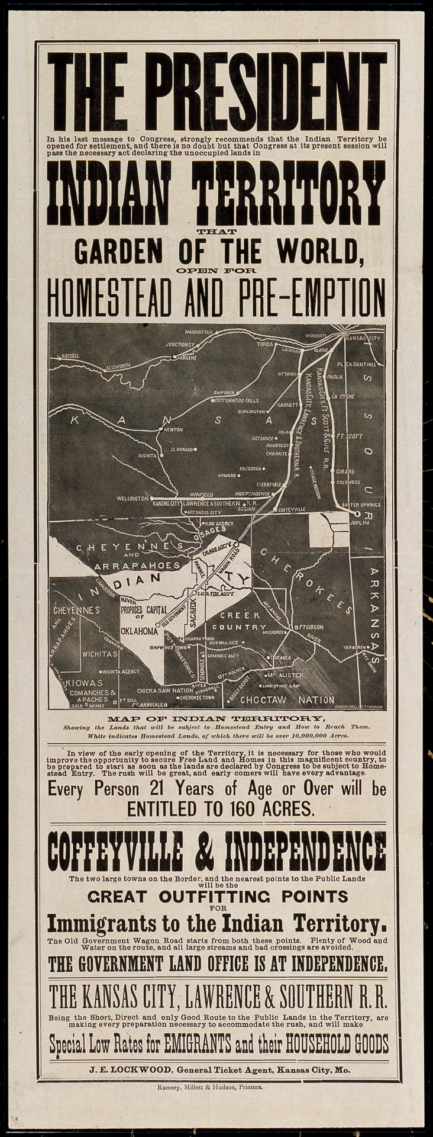
The Homestead Act
Directions: In 1862, President Lincoln officially signed the Homestead Act into law. After researching more about the Act, explain the reasons for its passage, what the Act did, what the opposition to it was, and the effect that it had on the United States.
Reasons for the Homestead Act
Type your response here.
Opposition to the Act
Type your response here.
What the Homestead Act Did
Type your response here.
Effect of the Act
Type your response here.

